Slide 1

Django Crash Course Day 1
Sean Wong
2025/08/05

Slide 2

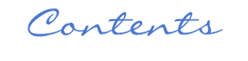
01.
Welcome & Why Django
02.
MVT Architecture
CONTENTS
03.
05.
Project vs App
Create & Run Project
04.
06.
Environment Setup
First App & View

Slide 3

CONTENTS
01.
02.
Templates & Static Files
Wrap-Up & Next Steps

Slide 4



01
Welcome & Why Django

Slide 5

Django Crash Course Day 1
Course Introduction
Course Objectives
Welcome to the Django Crash Course! Today, we'll cover the fundamentals of Django, a powerful Python web framework. By the end of this session, you'll have built your first Django app and understand the basics of web development with Django.
Our goal is to provide a hands-on introduction to Django. You'll learn how to set up your development environment, create a Django project, build an app, and deploy a basic homepage. This will lay the foundation for more advanced topics in future sessions.
Instructor Details
I'm your instructor for today. Feel free to ask questions at any time. Let's dive into the exciting world of Django and start building!
Course Logistics
Today's session is structured to be interactive. We'll cover theory and immediately apply it through practical examples. By the end of the day, you'll have a working Django app to showcase your learning.

Slide 6

What Exactly Is Django
Definition
Key Features
Django is a Python framework that makes it easier to create web sites using Python.
Django takes care of the difficult stuff so that you can concentrate on building your web applications.
Django includes an ORM for database interactions, a powerful admin panel, robust security features, URL routing, and a templating engine. These built-in components make it a comprehensive solution for web development.
Real-World Usage
Django powers many high-traffic websites, including Instagram, Pinterest, and Disqus. Its scalability and reliability make it a popular choice for both startups and large enterprises.

Slide 7

Core Reasons to Choose Django
Speed and Efficiency
Django accelerates development with its 'batteries-included' philosophy. It provides built-in features that handle common tasks, allowing developers to focus on writing their app without needing to reinvent the wheel.
Security and Scalability
Django is secure by default, protecting against common vulnerabilities like XSS, CSRF, and SQL injection. It is also highly scalable, capable of handling large amounts of traffic, making it suitable for applications of any size.

Slide 8
02
MVT Architecture

Slide 9

Django MVT Pattern Explained
Model
A Django model is a table in your database.
View
A view is a function or method that takes http requests as arguments, imports the relevant model(s), and finds out what data to send to the template, and returns the final result.
MVT vs MVC
Template
MVC: You write Model + View + Controller. Controller handles input and decides which view to show.
MVT (Django): You write Model + View + Template. Django acts as the Controller automatically.
Difference: In MVT, the “View” is logic, and the “Template” is the UI; Django handles the controller part for you.
The Template in Django is responsible for rendering HTML
URLs
URLs are like the ‘content page’.
When a user requests a URL, Django decides which view it will send it to.

Slide 10
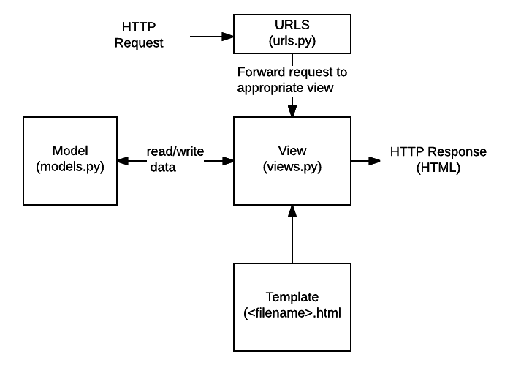
Django Request – Response Flow
Django receives the URL, checks the urls.py file, and calls the view that matches the URL.
The view, located in views.py, checks for relevant models.
The models are imported from the models.py file.
The view then sends the data to a specified template in the template folder.
The template contains HTML and Django tags, and with the data it returns finished HTML content back to the browser.

Slide 11
Django Requires Python
Django Requires Python
To check if your system has Python installed, run this command in the command prompt:
python --version
If Python is installed, you will get a result with the version number, like this
Python 3.12.4
If you find that you do not have Python installed on your computer, then you can download it for free from the following
website: https://www.python.org/

Slide 12
Virtual Environment
Each Django project should have its own virtual environment
Avoids dependency conflicts
Keeps projects clean and isolated
Use Python’s built-in **venv** to create one
Install Django in the virtual environment with PIP

Slide 13
03
Project vs App

Slide 14

Project and App Distinction
Project
App
A Django project is the overall configuration for your application. It includes settings, URL declarations, and deployment configurations. It acts as the container for all your apps.
An app is a modular, reusable component that performs a specific function within a project. Examples include a blog, a user authentication system, or a store. Apps can be reused across multiple projects.
Relationship
A project can contain multiple apps, each focused on a specific feature. This modular approach makes it easier to manage and scale your application. Apps can be developed independently and integrated into different projects.

Slide 15
04
Environment Setup

Slide 16

Preparing Your Local Environment
Python Installation
Ensure you have Python 3.10 or higher installed. Python is the core language for Django development. You can download it from the official Python website. Verify your installation by running 'python --version' in your terminal.
Virtual Environment
Create a virtual environment using 'python -m venv venv'. This isolates your project dependencies. Activate it with 'source venv/bin/activate' on macOS/Linux or 'venv\Scripts\activate' on Windows. Install Django using 'pip install django'.

Slide 17
05
Create & Run Project

Slide 18

Bootstrapping a Django Project
Start Project
Project Structure
Settings File
Use the command 'django-admin startproject myproject' to create a new Django project. This command generates the basic structure for your project, including settings, URLs, and a management script.
The generated project includes several key files: 'settings.py' for configuration, 'urls.py' for URL routing, 'manage.py' for command-line utilities, and 'wsgi.py' and 'asgi.py' for deployment interfaces.
The 'settings.py' file contains all the configuration for your Django project. It includes database settings, installed apps, middleware, and more. This file is crucial for customizing your project's behavior.
URL Routing
The 'urls.py' file defines the URL patterns for your project. It maps URLs to views, allowing Django to know which view should handle a particular request. This file is essential for organizing your application's navigation.

Slide 19

Launching the Dev Server
Run Server
Server Features
Start the Django development server using 'python manage.py runserver'. This command launches a lightweight web server on your local machine, accessible at http://127.0.0.1:8000/.
The development server automatically reloads when you make changes to your code, providing instant feedback. This feature is invaluable during development, allowing you to see the results of your changes immediately.
Welcome Page
When you visit the default URL, you'll see Django's welcome page, featuring a rocket icon. This confirms that your server is running and your project is set up correctly.

Slide 20
06
First App & View

Slide 21


Scaffolding Your First App
Create App
Use 'python manage.py startapp core' to create your first Django app. This command generates a new directory with several files, including 'views.py', 'models.py', 'urls.py', and a 'templates' folder.
App Structure
The 'views.py' file is where you define your views. 'models.py' is for database models. 'urls.py' is for URL routing within the app. The 'templates' folder will hold your HTML files.
Register App
Don't forget to add your new app to the 'INSTALLED_APPS' list in 'settings.py'. This step is crucial for Django to recognize and include your app in the project.

Slide 22

Writing a Minimal View
View Definition
In 'views.py', define a view function that takes a request object and returns an HttpResponse. For example, 'def home(request): return HttpResponse("Hello, Django!")'. This is the simplest form of a view.
Request-Response Cycle
A view in Django is a callable that takes a web request and returns a web response. This can be an HttpResponse object containing HTML content, a redirect, or even an error response. Views are the core of Django's request handling.

Slide 23


Connecting URLs to Views
URL Configuration
In 'core/urls.py', use 'path()' to map URLs to views. For example, 'path('', home, name='home')' maps the root URL to the 'home' view. This allows Django to route requests to the correct view.
Include Function
Path Parameters
Modular Routing
In the project's 'urls.py', use 'include()' to include the app's URL patterns. For example, 'path('', include('core.urls'))' includes the URLs defined in 'core/urls.py'. This keeps URL patterns modular.
The 'path()' function takes three arguments: the URL pattern as a string, the view function, and an optional name for the URL. The name parameter is useful for referencing URLs in templates and views.
Using 'include()' allows you to organize your URL patterns by app. This makes your project more maintainable and scalable. Each app can manage its own URLs independently.

Slide 24
07
Templates & Static Files

Slide 25

Rendering HTML via Templates
Template Creation
Create a template file in 'core/templates/core/home.html'. This file will contain the HTML for your view. For example, you can write '<h1>Welcome to Django!</h1>'.
Render Function
Update your view to use 'render()' instead of 'HttpResponse'. For example, 'return render(request, "core/home.html")'. This function combines a template with a context dictionary to produce an HttpResponse.
Separation of Concerns
Templates allow you to separate HTML from Python code. This separation makes your code more readable and maintainable. It also allows designers to work on templates without touching the backend logic.

Slide 26

Template Request Flow
Request Flow
The request flow in Django starts with a browser request, which is routed through the URL dispatcher to the appropriate view. The view then renders a template and returns an HttpResponse.
Template Loader
Django uses a template loader system to find templates. It searches through directories specified in the 'TEMPLATES' setting. This system ensures that templates are easily locatable and reusable.

Slide 27

Serving Static Assets
Static Files
Static files include CSS, JavaScript, and images. These files are not generated dynamically and are served directly to the browser. Django provides a way to manage these files.
Static URL
Configure 'STATIC_URL' in 'settings.py' to specify the URL prefix for static files. For example, 'STATIC_URL = "/static/"'. This setting tells Django where to serve static files from.
Template Tag
Use the '{% load static %}' template tag to include static files in your templates. For example, '<link rel="stylesheet" href="{% static 'css/style.css' %}">'. This ensures that static files are correctly referenced.

Slide 28
08
Wrap-Up & Next Steps

Slide 29

Day 1 Concept Recap
Understanding MVT
We explored the MVT architecture, which stands for Model-View-Template. This pattern separates concerns, making it easier to manage and scale applications.
What Is Django
Setting Up Environment
Today, we learned that Django is a high-level Python web framework designed for rapid development and clean design. It includes many built-in features that simplify web development.
We set up our development environment by installing Python, creating a virtual environment, and installing Django. This ensures that we have a clean and isolated workspace for our project.
Creating Project & App
We created a Django project and an app within it. We learned how to define views, set up URL routing, and render templates. This forms the basis for building web applications with Django.

Slide 30

Mini Project Assignment
Build Homepage
Your task is to build a homepage using a template. Display a welcome message, your name, and optionally today's date. This will give you hands-on practice with templates and views.
Stretch Goal
For a stretch goal, create a second page and link between the two pages. This will help you practice URL routing and template inheritance. Share your results with the class!

Slide 31

Q&A and Discussion Prompts
App Structure
MVT Confusion
What are your thoughts on structuring apps within a project? How do you plan to organize your apps for future projects? Share your ideas and strategies.
What aspects of the MVT architecture were confusing? Understanding MVT is crucial for effective Django development. Let's clarify any doubts you might have.
Environment Setup
Did you encounter any challenges while setting up your development environment? Let's discuss common issues and solutions to ensure a smooth setup process.

Slide 32

End of Day 1 Celebration
Congratulations
Great work! You've made it through Day 1 of the Django Crash Course. Tomorrow, we'll dive into models, the Django ORM, and the admin panel. Keep practicing and exploring. Links to Django docs and resources are provided for further learning.

Slide 33


THANK YOU
Sean Wong
2025/08/05

